Slide 1
python
Here is where your way to programming begin

Slide 2
TABLE OF CONTENTS
01
03
02
04
Python intro
syntax
Features of python
practical

Slide 3
01
Python intro

Slide 4

Uses of python
web development (server-side)
software development
mathematics
AI, ML, DL

Slide 5
What in python
Interpreted language: Python is an interpreted programming language, meaning an interpreter executes code line by line at runtime.
Multi-platform: Being interpreted, Python code can run on many platforms including Windows, Linux, Mac without recompilation like C/C++.
Clear syntax: Python code is generally very readable due to its clear and simple syntax with indentation used to delimit code blocks rather than braces or keywords. This makes Python code very easy to read and understand
Libraries: a collection of pre-written code

Slide 6
Python data type
Text Type: | string
Numeric Types: | int, float, complex
Sequence Types: | list, tuple, range
Mapping Type: | dict
Set Types: | set

Slide 7
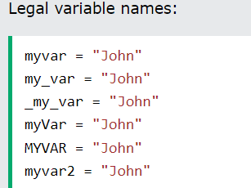
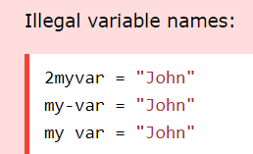
Variables

Slide 8
